Slide 1
Beginning Art: Mixed Media Collage
Encouraging and improving your drawing and composition skills through a variety of materials.

Slide 2
What does it mean to collage?...
“A technique of composing a work of art by pasting on a single surface various materials not normally associated with one another, as newspaper clippings, parts of photographs, theater tickets, and fragments of an envelope.”

Slide 3
Supplies that can be used…
Surface: You need to have a sturdy surface to attach your materials to. this could be but not limited to - poster board, foam board, card board (cereal box, soda can box, corrugated, etc.), wood, canvas, and more.
Adhesive: Any form of glue (white glue, glue stick, hot glue, mod podge, spray adhesive) literally any kind of glue you have at home will be great. If you don’t have access to glue you can make wheat paste! Here is a video link on how to make it… Wheat Paste Video. Stapling, tape, and sewing works too!
Materials that can be attached: The great part of collage is it is very open ended on what you can use. I recommend gathering items from around the house and outdoors that interest you. Here are some I recommend. (MAGAZINES, news paper, tissue paper, wrapping paper, colored paper, ribbon, string/yarn, photos, silk/pressed flowers, fabric, beads, dried beans and rice).
You can also use unconventional materials to create with. You can paint with strongly brewed coffee or tea, food coloring, make up, nail polish, foods like berries or blended up veggies. No limits really! Obviously ask an adult at home before you do this!

Slide 4
Examples…
Now lets look at some examples of collages. Feel free to look up more references on your own. I just likes these ones.

Slide 5
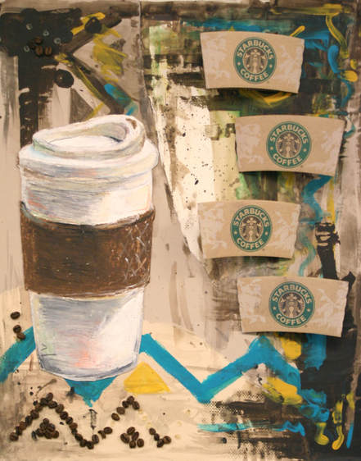

Slide 6
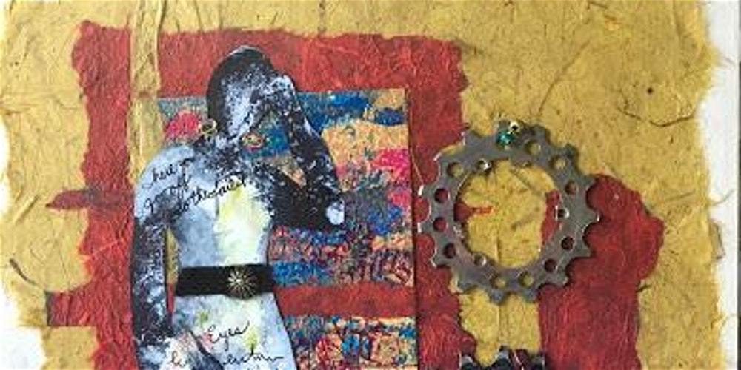

Slide 7
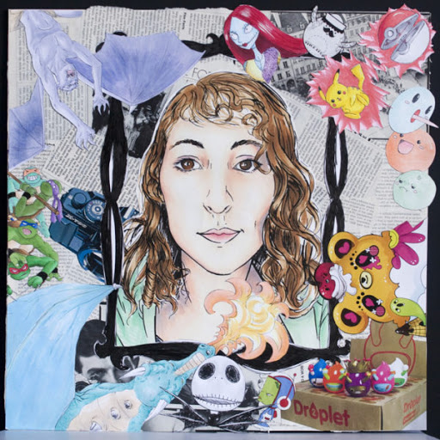
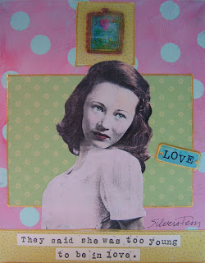

Slide 8
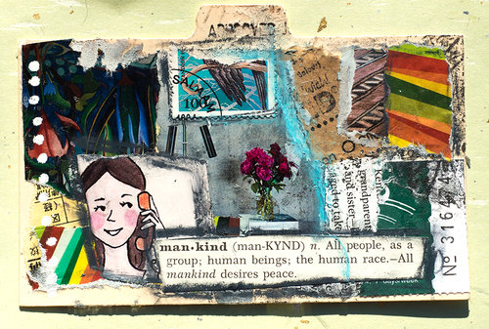

Slide 9
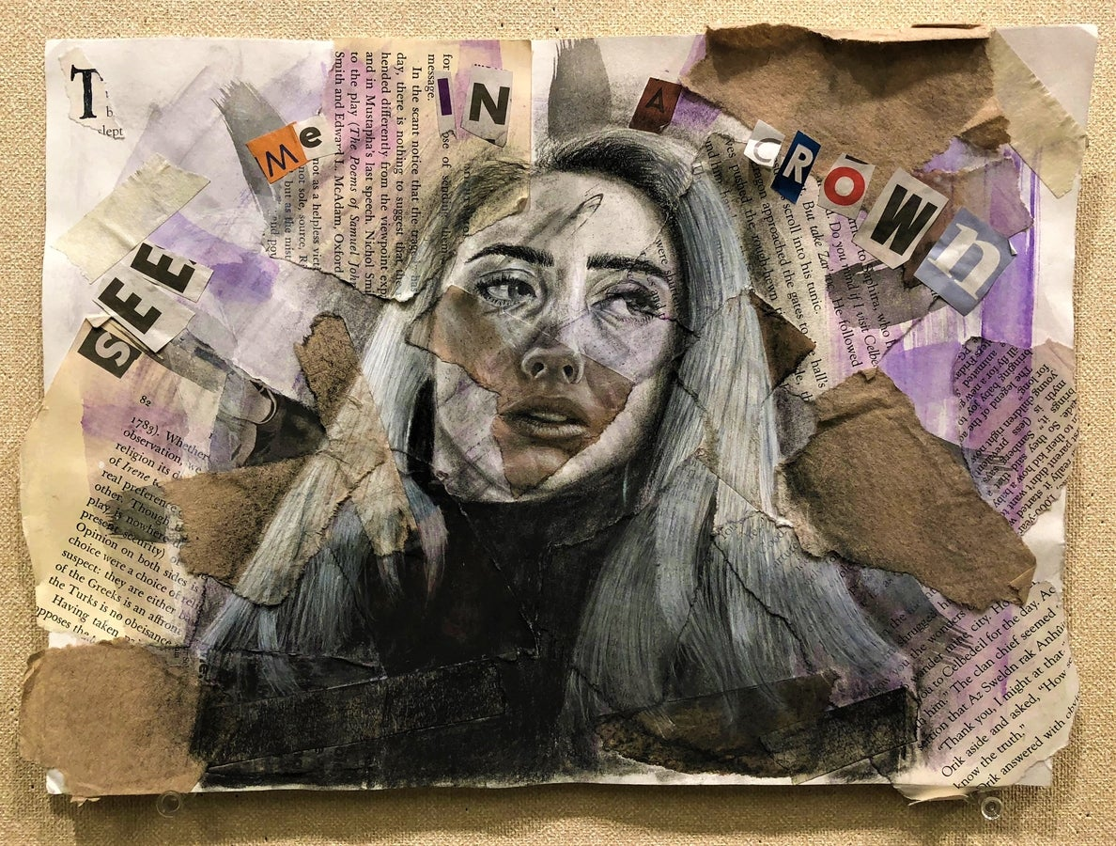

Slide 10
