Slide 1
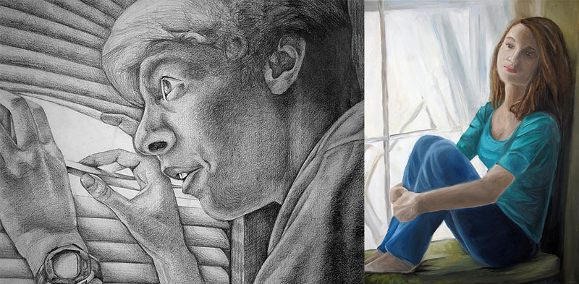
ISOLATION PORTRAIT: What does that look like for you?

Slide 2
Who is the inspiration?
The artist we are focusing on for this project is Edward Hopper. Many of his works have an underlying theme of isolation. He is probably most known for his 1942 painting “Nighthawks”.

Slide 3
Examples…
“Cap Code Morning”, 1950.
“Four Lane Road”, 1956.

Slide 4
Examples…
“High Noon”, 1949.
“Gas”, 1940.

Slide 5
Requirements…
For this project I want you to think about how this home isolation has affected you.
What has the experience been like for you and your family?
How can you express what you are feeling through art? Specifically through a portrait?
Through the piece how can you incorporate Edward Hopper’s style?
Materials/size:
This is very open ended due to what supplies you have at home. If possible I’d prefer a drawing or painting (this can be digital if you have the technology) again preferably no smaller that 9”x12”.
Subject:
You have a choice of a self portrait or of someone at home (animals can be included but not the focus) in any style you choose. This could be realistic, abstracted, cartoon/comic book style, etc.
Think about the surrounds and background and how you can use it to convey the feeling or tone of your piece.

Slide 6
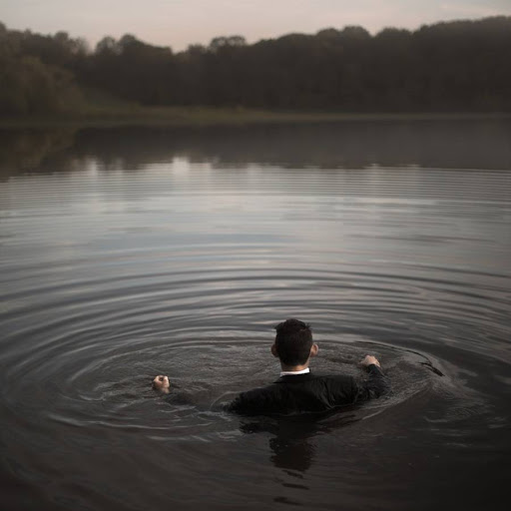
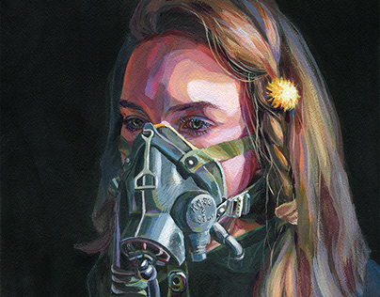
Here are some pieces to draw inspiration from…

Slide 7
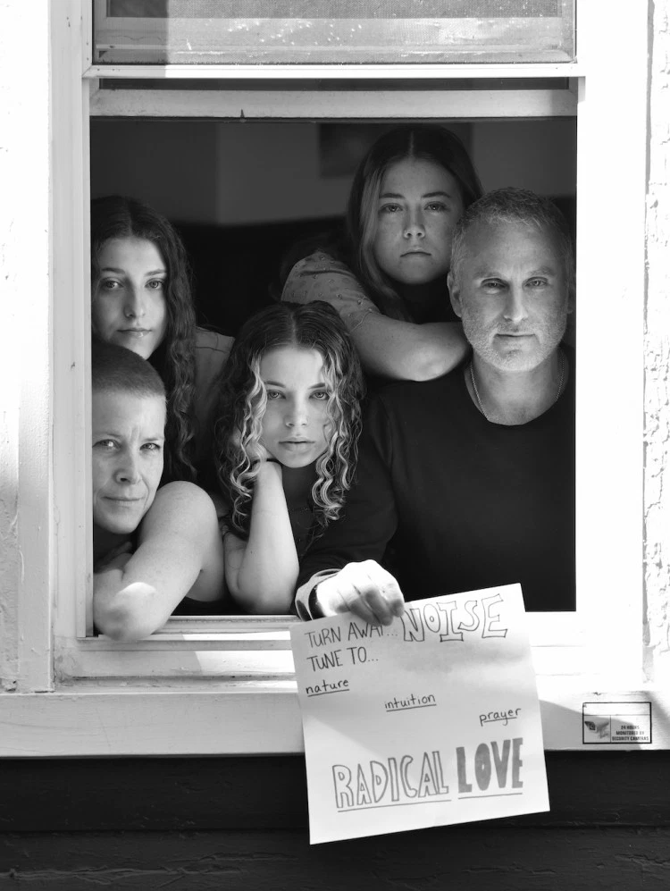

Slide 8
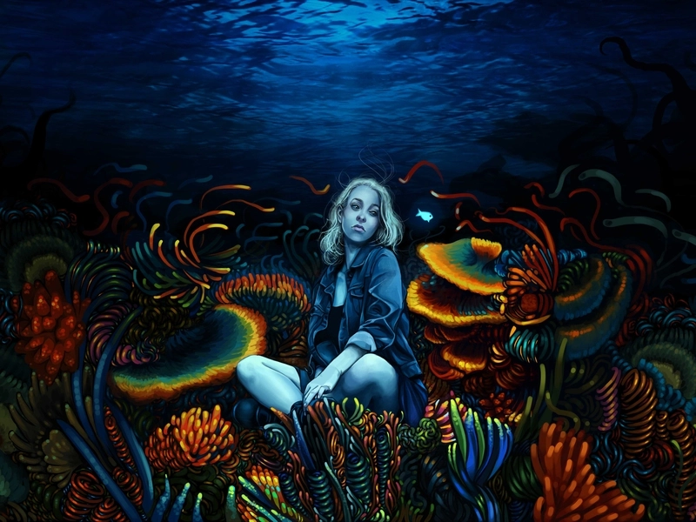

Slide 9
