Slide 1
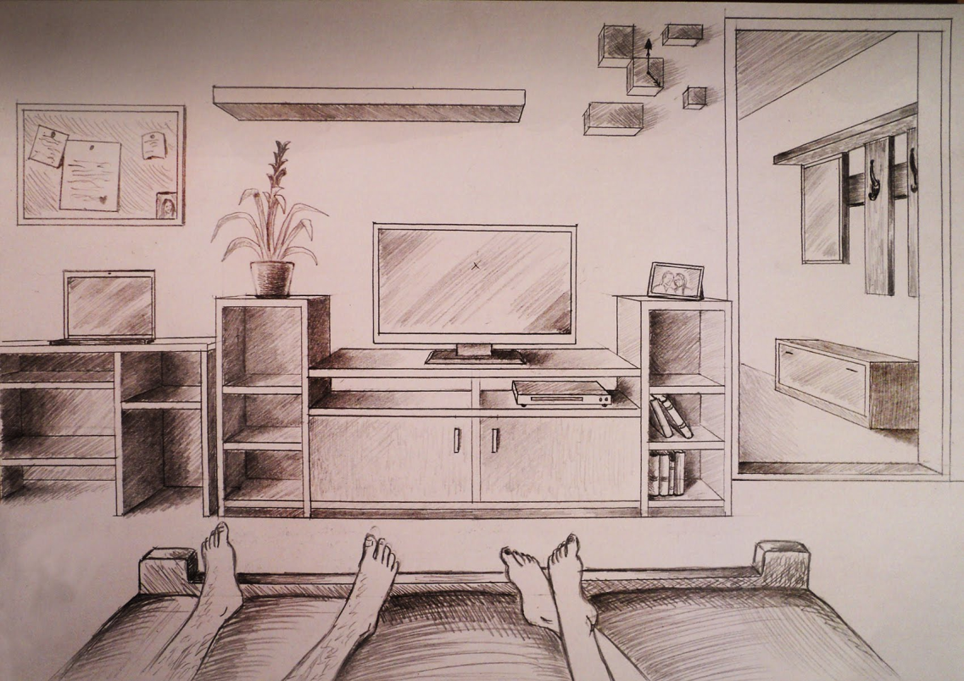
Interior perspective drawing
What is your view during this time at home?

Slide 2
Requirements…
Draw an interior of a room in one or two point perspective. This could be bedroom, bathroom, kitchen, living room, hallway, etc.
All objects and walls should be parallel with your point of view.
Include at least 10 objects in your room. This could be furniture, items hanging on walls, lights, fans, windows, curtains, rugs, etc.
I encourage you to draw from real life, but if you want to draw from an image that is acceptable as well.
Preferable on paper no smaller than 9”x12” but if all you have is copy paper that will be fine.
Materials are your choice. I recommend starting this in a light pencil sketch regardless. Color is encouraged but not required.

Slide 3
Examples of one point perspective.

Slide 7
Examples of two point perspective.

Slide 11
Things to remember… Techniques to show the illusion of space
Overlapping - Overlapping occurs when objects that are closer to the viewer prevent the view of objects that are behind them.
Size - Objects that are smaller will appear further away from the viewer.
Placement on the paper - Objects placed higher within the picture plane will appear further away.
Detail - Objects that are further away should have less detail than objects that are closer to the viewer.
Color - Objects that are further away are cooler in color temperature, while objects that are closer are warmer.
Value - Objects that are further away are lighter in value, while objects that are closer are typically darker in value.
Linear Perspective - Linear perspective is a drawing method that uses lines to create the illusion of space on a flat surface.

Slide 12
Video resources…
One-point bedroom
One-point room
One-point hallway
Two-Point kitchen
Two-point bedroom
Two-point bathroom

