Slide 1
Intermediate Art: Book Making
The combination of a topic personal to you, paired with the style of a artist…

Slide 2
Objectives…
Students are to demonstrate their knowledge of an artist of their choosing along with an event or theme personally important to them. This will be combined to form a hand made book using a variety of medias.

Slide 3
My own example…
The following images are an example that I made in 2016. My book is the fusion between the events of the Northern Arizona Yarnell Hill Fire in 2013 that claimed the lives of 19 hotshot firefighters and mixed media collage techniques inspired by artist Elliott Hundley. I use poems from Dylan Thomas as a narration throughout the pieces.

Slide 4
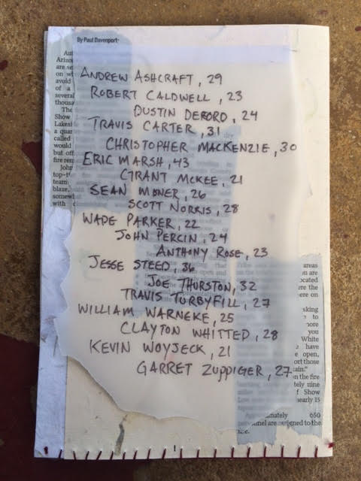
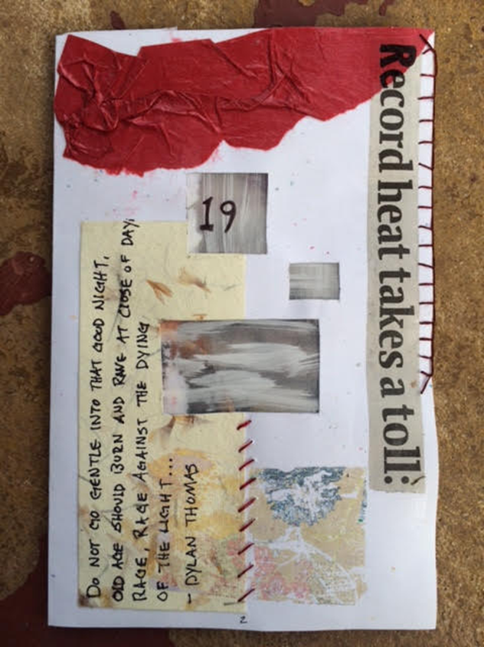

Slide 5
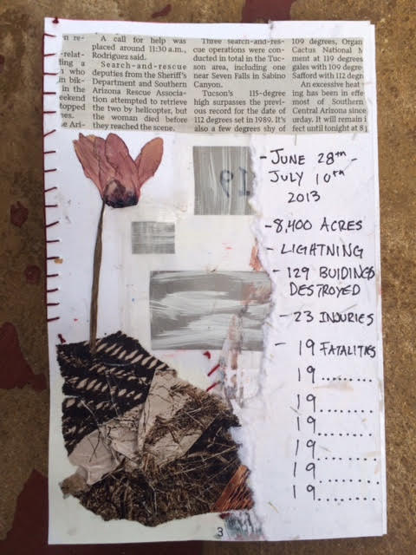
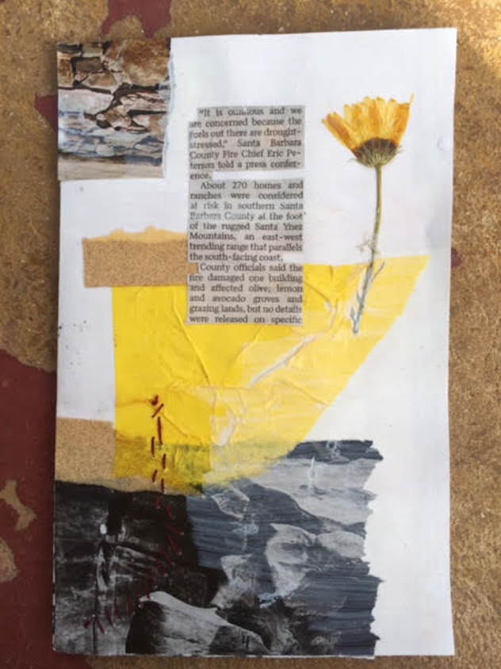

Slide 6
