Slide 1
Requirements…
Minimum of 8 pages. (Optional cover)
A variety of media is encouraged but 3 is the minimum.
The book needs to bound in some way. Try and be creative with this (sewn with thread, yarn, wire, hole punched with rings, really anything will work!)
Does not need to follow classic book structure. You could make an accordion form, a pop up, a box that opens up! Have fun with your design!
Once finished I would like you to respond to the following questions about your book.
Clearly and simply state the central idea of your book.
Explain how the work in your book demonstrates your intent and the combination of your two ideas. You may refer to specific images as examples.
*writing can be turned in with images of you completed book*

Slide 2
Process…
Brainstorm ideas: In your sketchbook or any paper really make a list of at least 5 current events, movements, or topics you are interested in personally. They can be serious (global warming, deforestation, #metoo movement, gender equality, etc.) or more relaxed (STAR WARS, video games, sports, your love of ice cream, etc.).
Research artists: Investigate at least 3 artists whose style you are interested in. I would prefer you choose a modern artist, meaning someone that has made or is currently making art in the last 50 years. If you REALLY want to focus on an artist that is older than that (Van Gogh, Monet, Matisse, etc.) please get my approval first.
Once you decide your theme and artist, send me a Remind message! I’d like to know what you’ll be focusing on. Ill check in with everyone this Friday 4/3 to see where you are all at and determine a due date from there. My guess is this will be 2+ weeks.

Slide 3
How to make a book!
So many options for this. You can fold a single piece of a large paper to make a book or make separate pages and bind them together. In my example I had 7 pages that I folded in half then bound. Below are two helpful videos.
Fancy book with sewn binding
No glue book making
Obviously we are not in the art room so your supplies are what you have at home! Be creative with what you have, no matter what you make it will be great.
Think about upcycling things around your house or from outside. Strong brewed Coffee or tea can be used like watercolor. Make up, nail polish, berry juice, etc. can also be used!
If you do not have glue you can make wheat paste!
Wheat Paste recipe

Slide 4
More Examples!

Slide 6
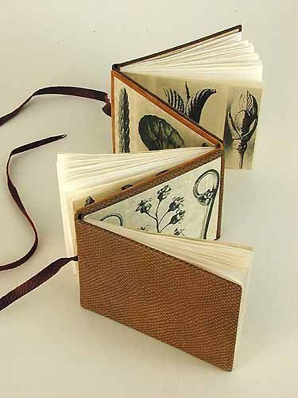
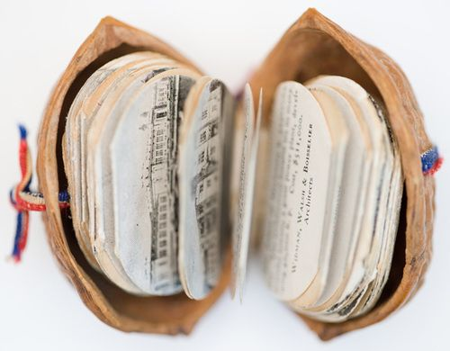

Slide 7
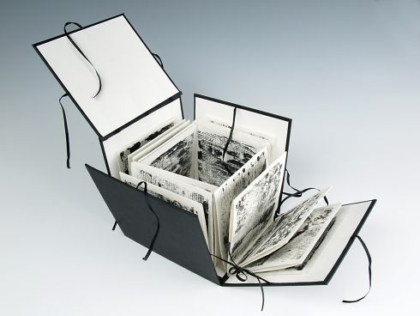

Slide 8
Example for the writing portion…
Clearly and simply state the central idea of your book.
My book is the fusion between the events of the Northern Arizona Yarnell Hill Fire in 2013 that claimed the lives of 19 hotshot firefighters and mixed media collage techniques inspired by artist Elliott Hundley. I use poems from Dylan Thomas as a narration throughout the pieces.
2. Explain how the work in your concentration demonstrates your intent and the sustained investigation of your idea. You may refer to specific images as examples.
Each piece contains a connection to both of the themes through a literal or suggested representation of the Yarnell Fire and Hundley’s collaging process. For example slide 7 page 3, juxtaposes the statistics of the fires damage with the layering and subtraction of media of the surface. Slide 10 page 6 is a continuation of the theme purely represented by burned paper incorporated by collage.

