Slide 1
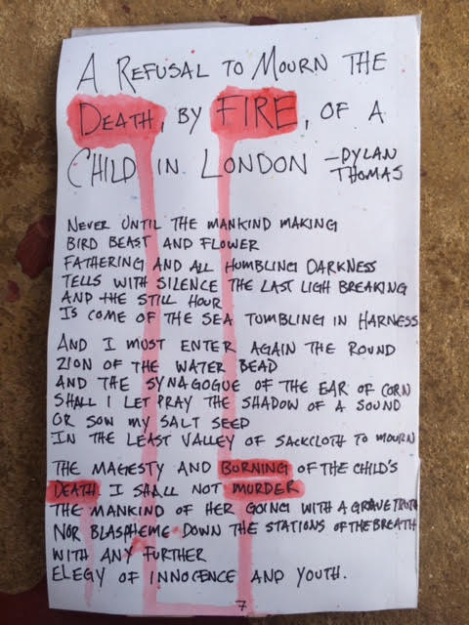
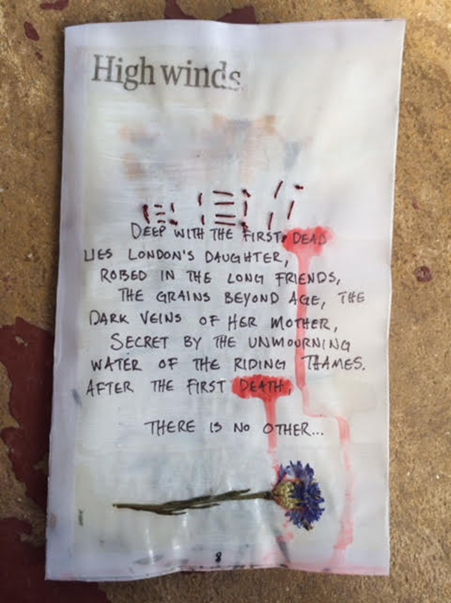

Slide 2
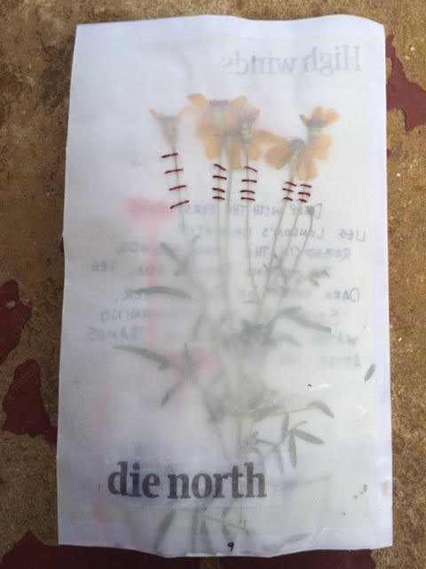
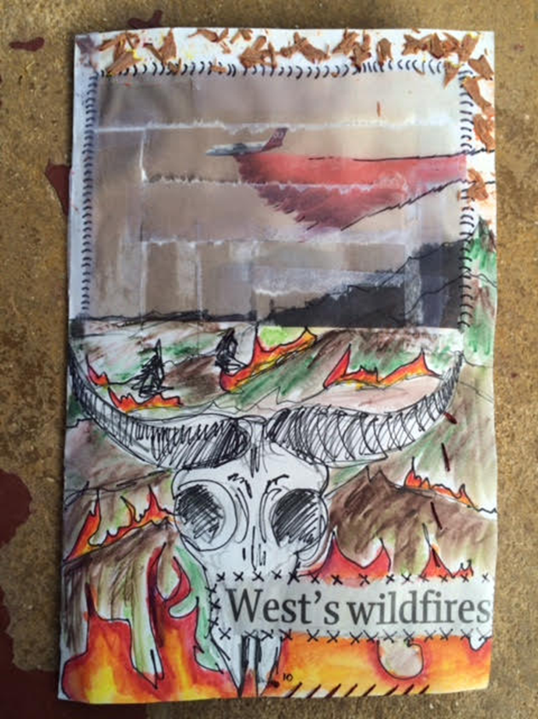

Slide 3
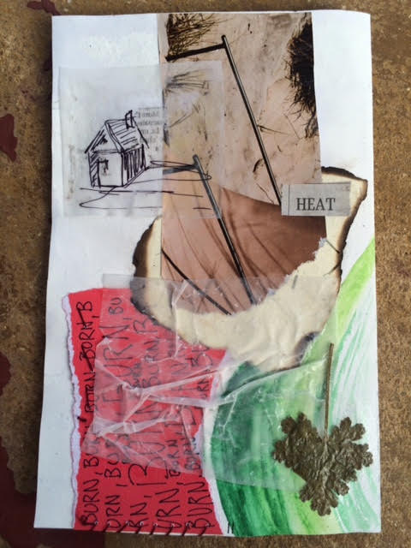
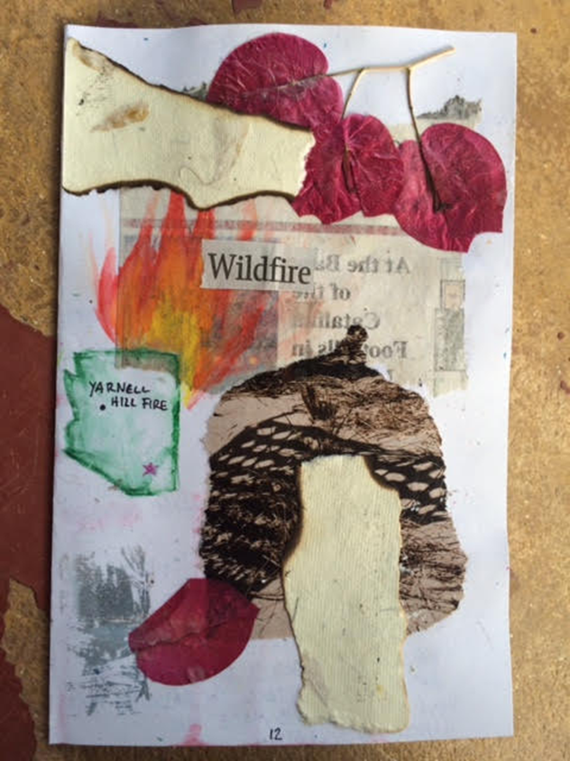

Slide 4
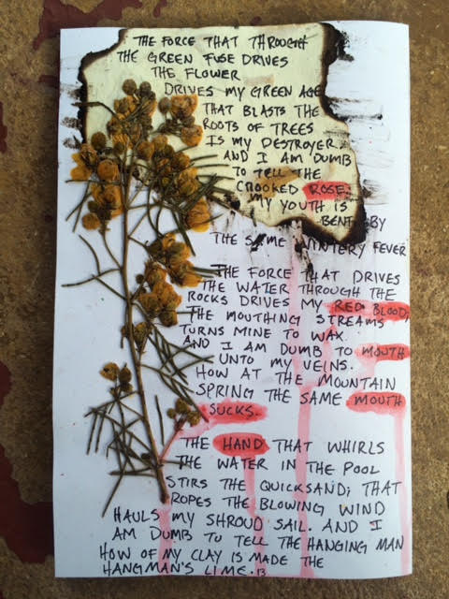
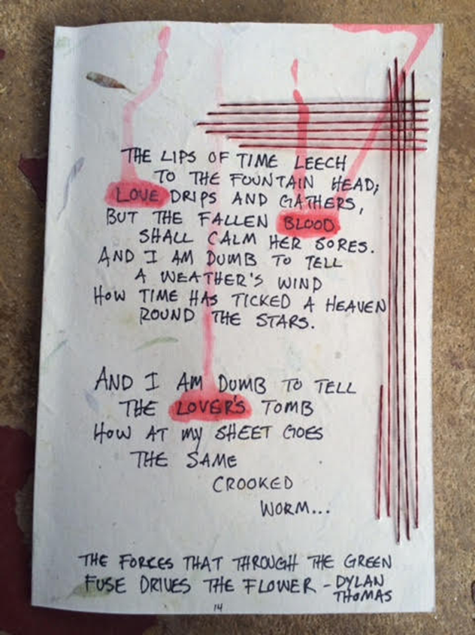

Slide 5
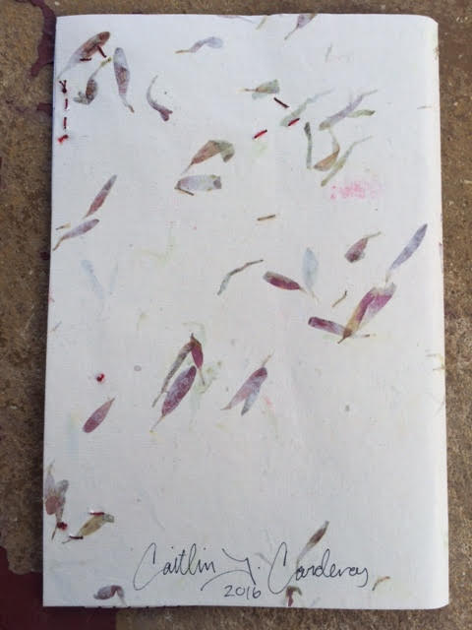
Materials used:
Handmade paper, colored paper, transparent vellum paper, magazines, newspaper, pressed flowers, embroidery thread, watercolor, micron pen.
I also used Mod Podge, white glue, and glue sticks to adhere the media.
To bind the book I sewed the spine with more embroidery thread.

